Slide 1
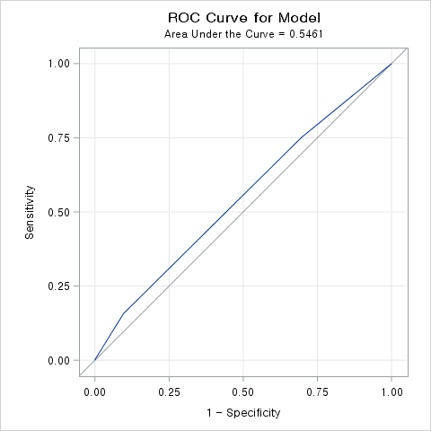
Event: Early complication Yes
Variable: ASA score
Chisq test p-value <.0001
Univariate logistic regression
p-values were not significant, AUC=0.5461
Cut-off probability maximizing Youden’s J index=0.3039
 | Complication
ASA score | Yes | No | Total
I | 189 (18.2) | 851 (81.8) | 1040
II | 448 (21.1) | 1671 (78.9) | 2119
III | 117 (30.39) | 268 (69.6) | 385
IV | 2 (66.7) | 1 (33.3) | 3
Total | 756 (21.3) | 2791 (78.7) | 3547
통계량 | Prob
카이제곱 | <.0001
우도비 카이제곱 | <.0001
Mantel-Haenszel 카이제곱 | <.0001
Parameter | Estimate | Standard Error | OR (95% CI) | Pr > ChiSq
Intercept | -0.7399 | 0.3082 |  | 0.0164
ASA_Score 2 vs 1 | -0.5764 | 0.3105 | 1.21 (0.99-1.46) | 0.0634
ASA_Score 3 vs 1 | -0.0889 | 0.3180 | 1.97 (1.50-2.57) | 0.7799
ASA_Score 4 vs 1 | 1.4300 | 0.9188 | 8.98 (0.81-99.4) | 0.1196
Classification Table
Prob Level | Correct |  | Incorrect |  | Percentages
 | Predicted Event | Predicted Non-Event | Predicted Event | Predicted Non-Event | Correct* | Sensitivity | Specificity | False POS | False NEG
0.01 | 756 | 0 | 2791 | 0 | 21.3 | 100 | 0 | 78.7 | .
0.1 | 756 | 0 | 2791 | 0 | 21.3 | 100 | 0 | 78.7 | .
0.2 | 567 | 851 | 1940 | 189 | 40 | 75 | 30.5 | 77.4 | 18.2
0.3 | 119 | 2522 | 269 | 637 | 74.5 | 15.7 | 90.4 | 69.3 | 20.2
0.4 | 2 | 2790 | 1 | 754 | 78.7 | 0.3 | 100 | 33.3 | 21.3
0.5 | 0 | 2790 | 1 | 756 | 78.7 | 0 | 100 | 100 | 21.3
*Correct classification rate= (# of True Positive + # of True Negative) / Total
Complication No인데 Yes로 예측
Complication Yes인데 No로 예측

Slide 2
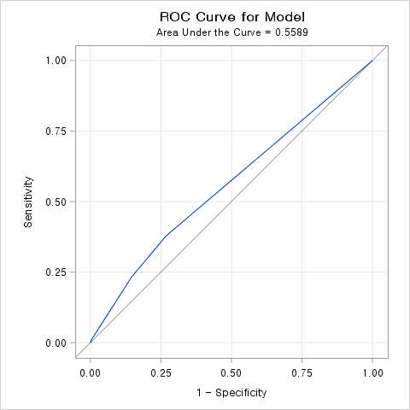
Event: Early complication Yes
Variable: Clinical stage (missing n=2)
Chisq test p-value <.0001
Univariate logistic regression
p-values are insignificant, AUC=0.5589
Cut-off probability maximizing Youden’s J index=0.2445
 | Complication
Clinical stage | Yes | No | Total
I | 470 (18.7) | 2041 (81.3) | 2511
II | 111 (24.5) | 343 (75.6) | 454
III | 168 (29.8) | 396 (70.2) | 564
IV | 7 (43.8) | 9 (56.3) | 16
Total | 756 (21.3) | 2789 (78.7) | 3545
통계량 | Prob
카이제곱 | <.0001
우도비 카이제곱 | <.0001
Mantel-Haenszel 카이제곱 | <.0001
Parameter | Estimate | Standard Error | OR (95% CI) | Pr > ChiSq
Intercept | -0.9264 | 0.1316 |  | <.0001
Clinical_Stage 2 vs 1 | -0.2018 | 0.1526 | 1.41 (1.11-1.78) | 0.1858
Clinical_Stage 3 vs 1 | 0.0689 | 0.1468 | 1.84 (1.50-2.27) | 0.6388
Clinical_Stage 4 vs 1 | 0.6750 | 0.3799 | 3.38 (1.25-9.12) | 0.0756
Classification Table
Prob Level | Correct |  | Incorrect |  | Percentages
 | Predicted Event | Predicted Non-Event | Predicted Event | Predicted Non-Event | Correct* | Sensitivity | Specificity | False POS | False NEG
0.01 | 756 | 0 | 2789 | 0 | 21.3 | 100 | 0 | 78.7 | .
0.1 | 756 | 0 | 2789 | 0 | 21.3 | 100 | 0 | 78.7 | .
0.2 | 286 | 2041 | 748 | 470 | 65.6 | 37.8 | 73.2 | 72.3 | 18.7
0.3 | 7 | 2780 | 9 | 749 | 78.6 | 0.9 | 99.7 | 56.3 | 21.2
0.4 | 7 | 2780 | 9 | 749 | 78.6 | 0.9 | 99.7 | 56.3 | 21.2
0.5 | 0 | 2789 | 0 | 756 | 78.7 | 0 | 100 | . | 21.3
*Correct classification rate= (# of True Positive + # of True Negative) / Total
Complication No인데 Yes로 예측
Complication Yes인데 No로 예측

Slide 3
Continuous variables descriptive statistics
Variable | N | Missing | Mean | Std.Dev | Median | 1Q | 3Q | Min | Max | T-Test* | F Test (Equal variance) | Mann-Whitney U test
EBL |  |  |  |  |  |  |  |  |  | 0.0006 | <.0001 | <.0001
Yes | 756 | 0 | 144.5 | 258.4 | 50 | 15 | 150 | 0 | 2200
No | 2,791 | 0 | 94.5 | 584.6 | 30 | 5 | 100 | 0 | 30000
WBC |  |  |  |  |  |  |  |  |  | 0.0006 | <.0001 | 0.0047
Yes | 756 | 0 | 6.6 | 2.1 | 6.285 | 5.25 | 7.47 | 2.71 | 19.57
No | 2791 | 0 | 6.3 | 1.8 | 6.1 | 5.03 | 7.31 | 1.05 | 16.17
Hemoglobin |  |  |  |  |  |  |  |  |  | 0.0128 | <.0001 | 0.0737
Yes | 756 | 0 | 13.6 | 2.1 | 13.9 | 12.4 | 15.15 | 5.9 | 18.4
No | 2791 | 0 | 13.8 | 1.9 | 14 | 12.8 | 15.1 | 5 | 18.4
Segmented Neutrophil |  |  |  |  |  |  |  |  |  | 0.2190 | 0.8326 | 0.3978
Yes | 756 | 0 | 13.6 | 2.1 | 13.9 | 12.4 | 15.15 | 5.9 | 18.4
No | 2791 | 0 | 58.1 | 9.4 | 58.1 | 52 | 64.5 | 5.8 | 92.2
ANC |  |  |  |  |  |  |  |  |  | 0.0018 | <.0001 | 0.0097
Yes | 756 | 0 | 3981.3 | 1858.2 | 3583.5 | 2849 | 4554.5 | 1111 | 24240
No | 2791 | 0 | 3752.1 | 1490.6 | 3519 | 2705 | 4464 | 803 | 14672
Lymphocytes |  |  |  |  |  |  |  |  |  | 0.0082 | 0.8284 | 0.0133
Yes | 756 | 0 | 31.5 | 8.8 | 31.5 | 25.5 | 37.05 | 6 | 79
No | 2791 | 0 | 32.4 | 8.7 | 32.2 | 26.6 | 38 | 4.2 | 75.9
Platelets |  |  |  |  |  |  |  |  |  | 0.0531 | 0.0015 | 0.0368
Yes | 756 | 0 | 260.1 | 77.8 | 251 | 210.5 | 300 | 57 | 743
No | 2791 | 0 | 254.1 | 71.1 | 244 | 208 | 289 | 61 | 829
Albumin |  |  |  |  |  |  |  |  |  | <.0001 | 0.0001 | <.0001
Yes | 756 | 0 | 4.2 | 0.4 | 4.3 | 4.0 | 4.5 | 2 | 5.2
No | 2791 | 0 | 4.3 | 0.3 | 4.3 | 4.1 | 4.5 | 1.9 | 5.3

Slide 4
Variable | N | Missing | Mean | Std.Dev | Median | 1Q | 3Q | Min | Max | T-Test* | F Test (Equal variance) | Mann-Whitney U test
NLR |  |  |  |  |  |  |  |  |  | 0.0546 | 0.2635 | 0.0578
Yes | 756 | 0 | 2.2 | 1.3 | 1.8 | 1.4 | 2.5 | 0.5 | 14
No | 2791 | 0 | 2.1 | 1.2 | 1.8 | 1.4 | 2.4 | 0.2 | 22
Cell Count |  |  |  |  |  |  |  |  |  | 0.5427 | 0.4749 | 0.7362
Yes | 756 | 0 | 2.0 | 0.7 | 1.91 | 1.6 | 2.39 | 0.44 | 5.35
No | 2791 | 0 | 2.0 | 0.7 | 1.92 | 1.5 | 2.37 | 0.2 | 7
PNI |  |  |  |  |  |  |  |  |  | 0.0087 | 0.0011 | 0.0075
Yes | 756 | 0 | 52.5 | 5.4 | 52.4 | 49.6 | 55.8 | 27.4 | 73.7
No | 2791 | 0 | 53.0 | 4.9 | 53 | 50.1 | 55.9 | 27.9 | 81
SII |  |  |  |  |  |  |  |  |  | 0.0889 | <.0001 | 0.0088
Yes | 756 | 0 | 574.4 | 418.3 | 468.5 | 325.0 | 696 | 71 | 3969
No | 2791 | 0 | 543.3 | 532.9 | 445 | 311.0 | 639 | 39 | 13854

Slide 5
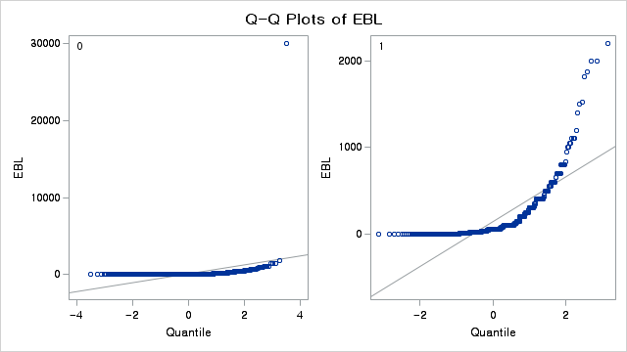
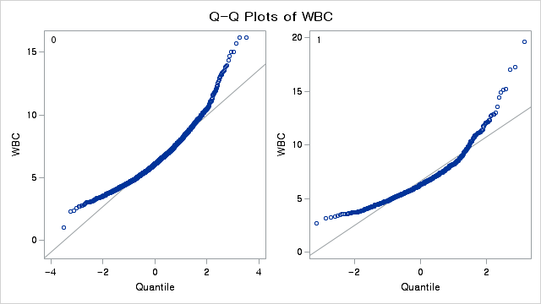
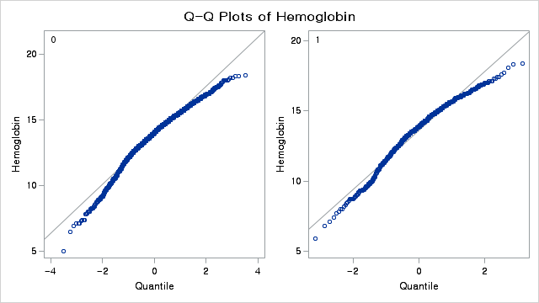
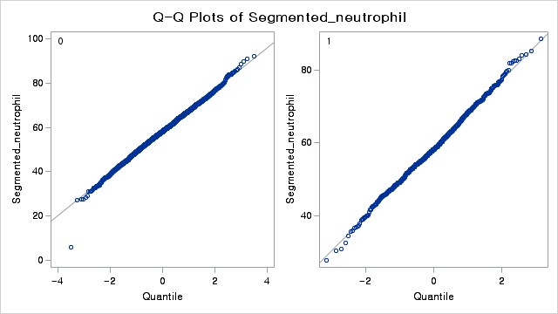

Slide 6
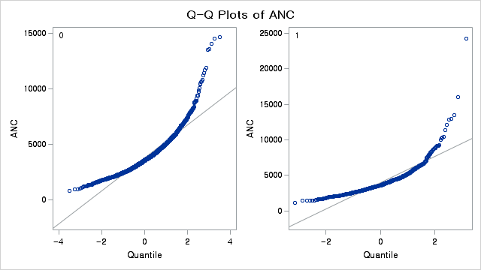
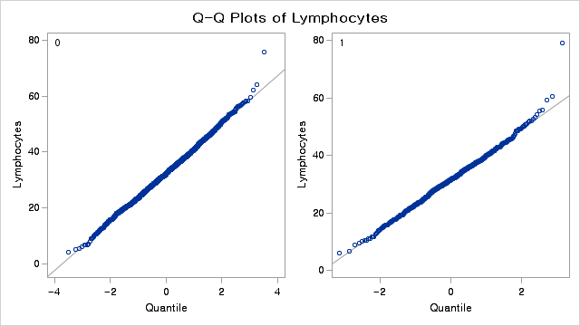
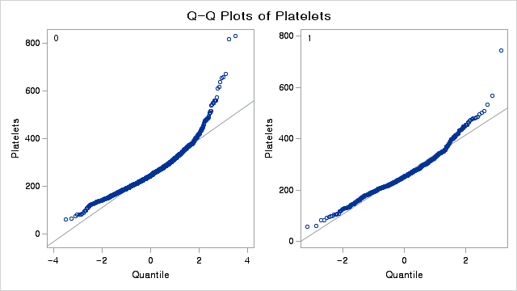
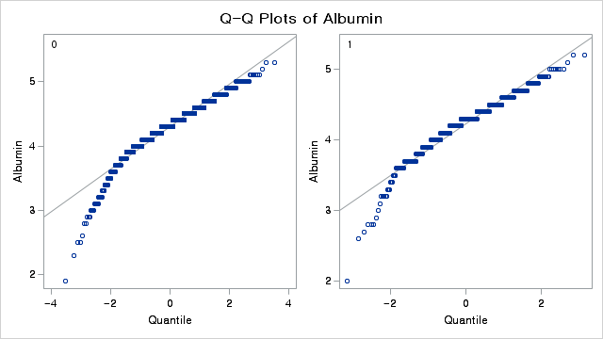

Slide 7
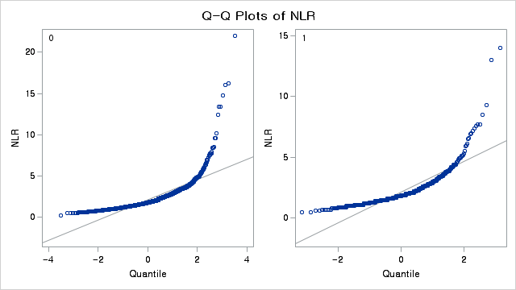
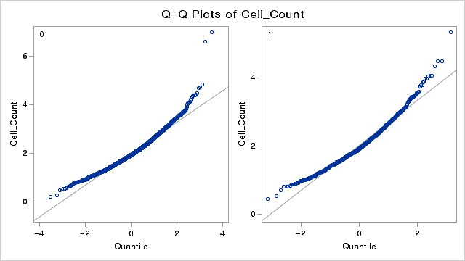
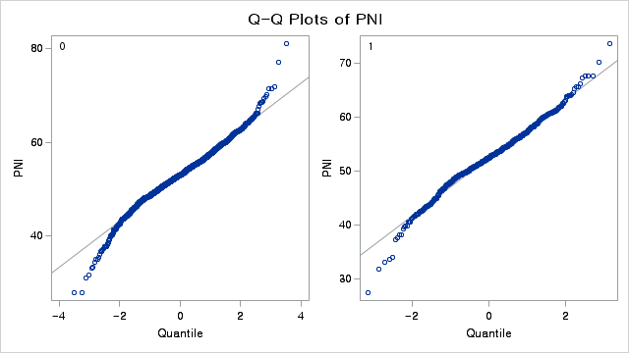
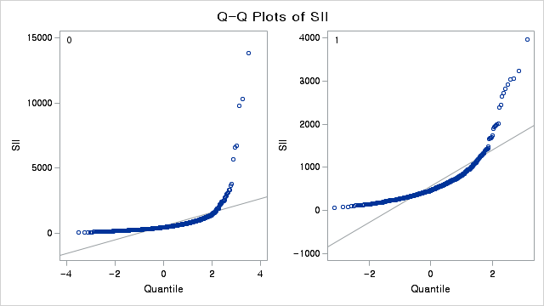

Slide 8
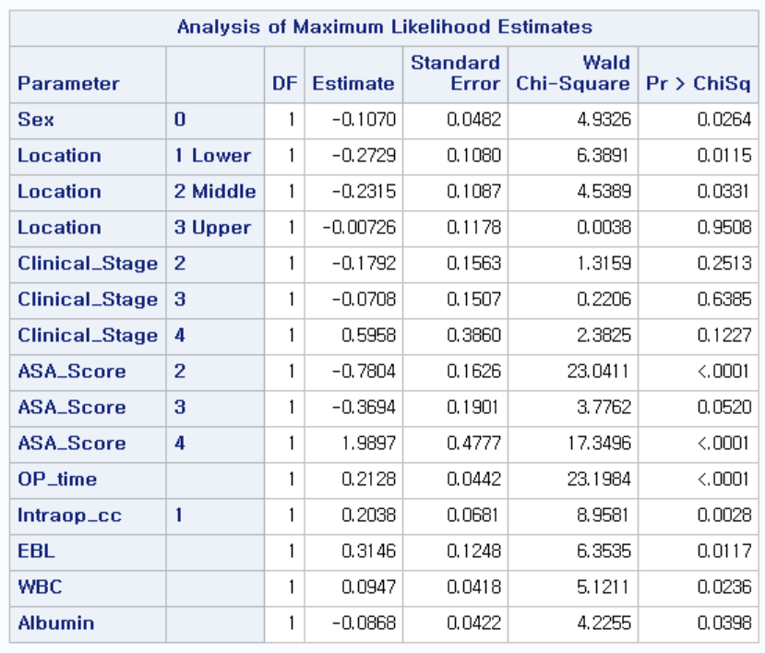
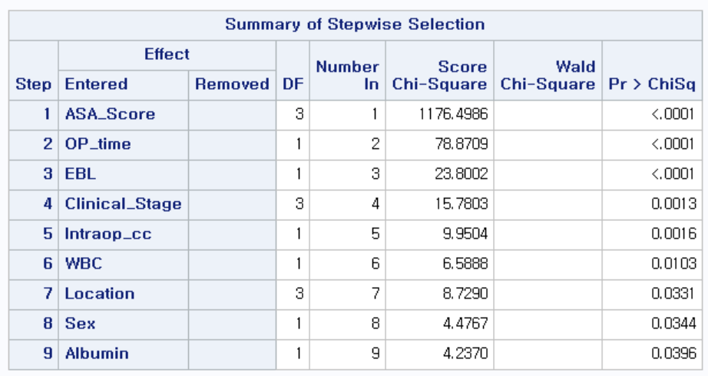
Multivariate logistic regression results
Pre-operative & Post-operative variables were used.
Event: Early complication Yes/No
No intercept model
Selected variables: Sex, Location, Clinical Stage, ASA Score, Op Time, Intra-op CC, EBL, WBC, Albumin
AUC=0.6364
Model with intercept
Selected variables: Sex, Location, LN Dissection, ASA Score, Op Time, Intra-op CC, EBL, WBC, Albumin
AUC=0.6353

Slide 9
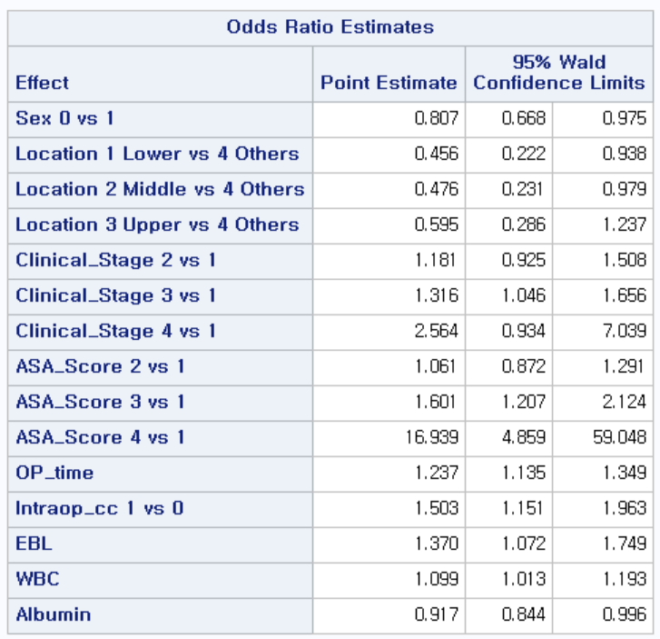
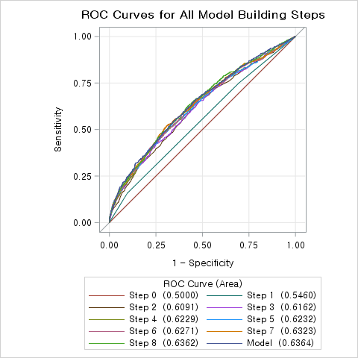
Multivariate logistic regression results

Slide 10
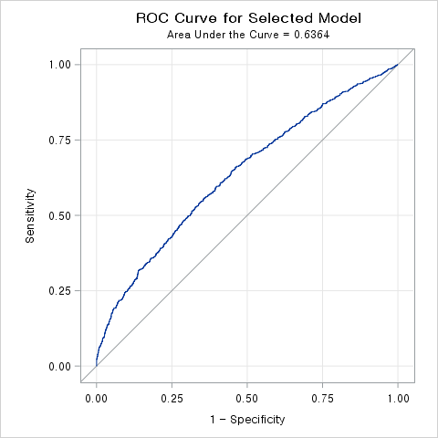
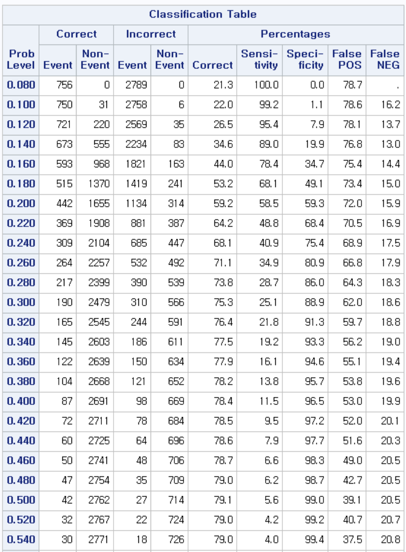
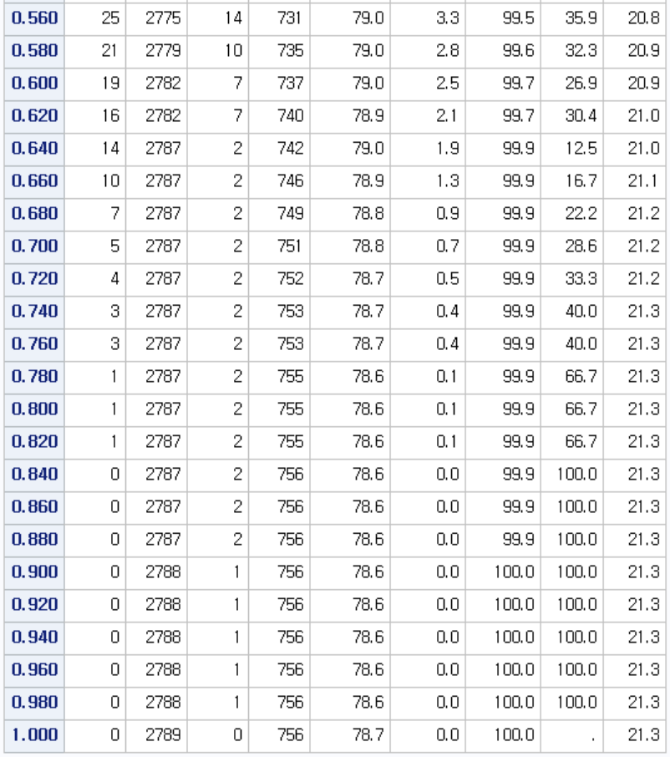
Multivariate logistic regression results
Sensitivity is decaying too fast.

Slide 11
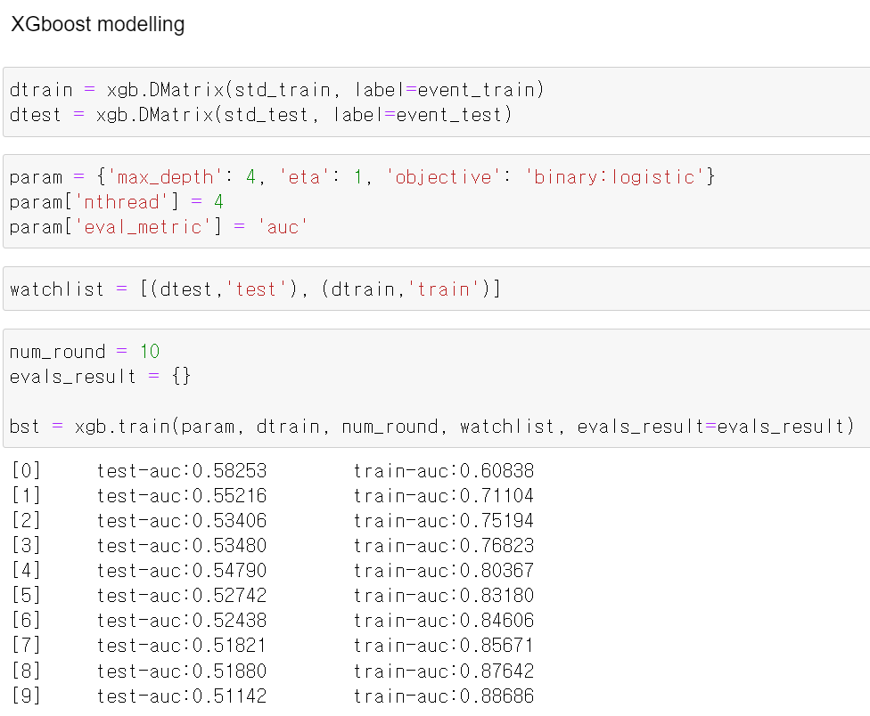
XGboost results
As a gold standard, XGboost results were derived.
Train set: 짝수 년도 수술 환자
Test set: 홀수 년도 수술 환자
Pre-operative & Post-operative variables were used.
Continuous variables were standardized using Robust Scaler from scikit-learn.
Max Train AUC=0.8869 but Max Test AUC=0.5825

